Slide 1
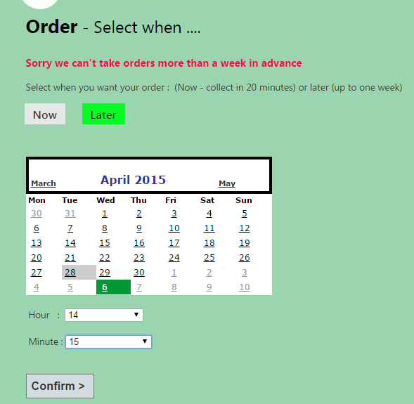
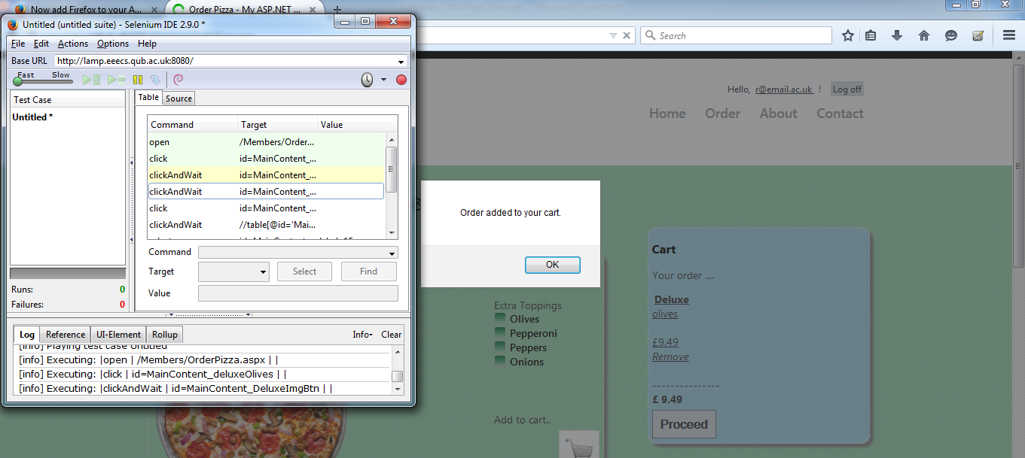
Schedule Order Page
Critical defects were caused by the order validation button still working after trying to order beyond the limit of one week
Automated Selenium Tests caused Major defects in testing as
the pop up boxes would cause ‘time outs’
Moderate and Exploratory issues such as
the ‘Now Service’ showing collection time
is 10 mins over what is expected

